Slide 1
Refresher Mathematics and Statistics in Python

Slide 2
Learning Goals Today
After today you should have a:
1. A basic understanding of probability
2. An understanding of Bayes Theorem
3. An understanding of Probability Distributions

Slide 3
Relation With Business?
1. It helps to make decisions
You can compute the probability of an outcome you care about, and prepare for it in the right way (example: insurance)
2. It is used for drawing conclusion based on small amounts of data
This is often used in research (example: market research)

Slide 4
Probability Rules & Conventions

Slide 5
Probability Notation
Probability is given the symbol P
P is always in between 0 and 1 (in math language: 0 ≤ P ≤ 1)
0 = 0% chance of something happening
1 = 100% chance of it happening

Slide 6

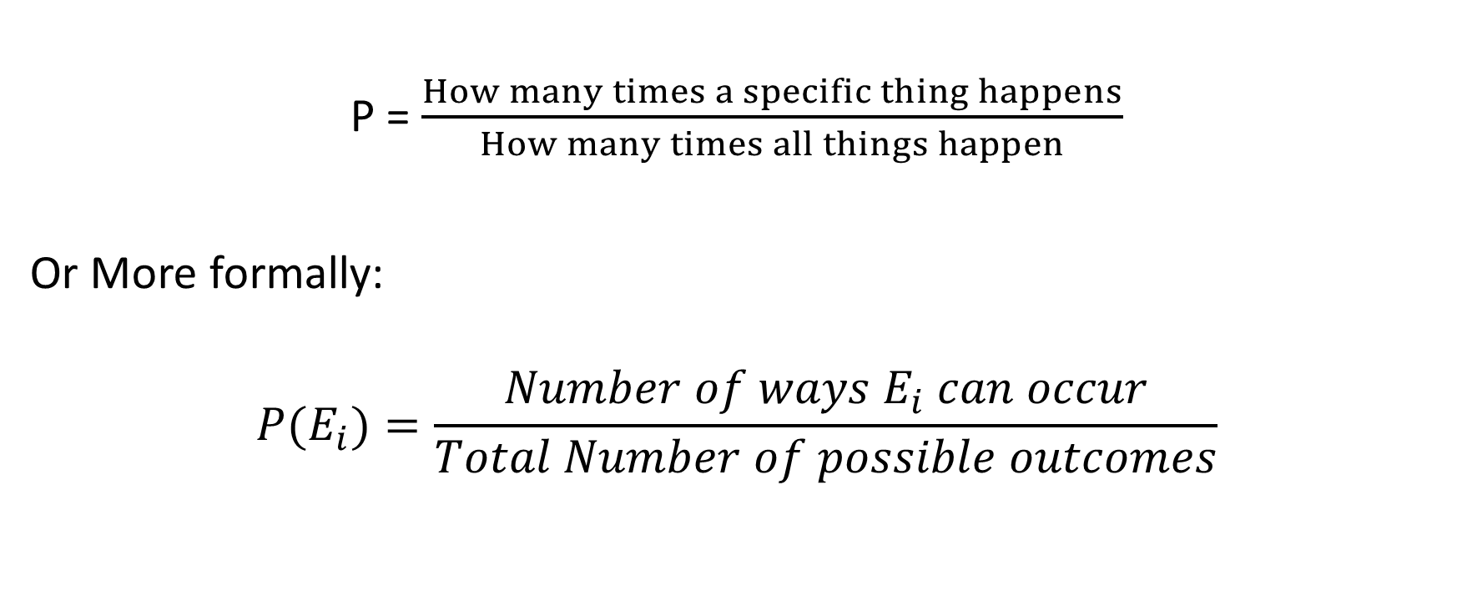
Basic Formulas
P = $\frac{How many times a specific thing happens}{How many times all things happen}$
Or More formally:
$$P(E_{i})=\frac{Number of ways E_{i} can occur}{Total Number of possible outcomes}$$
${(E}_{i}$ means Event)

Slide 7
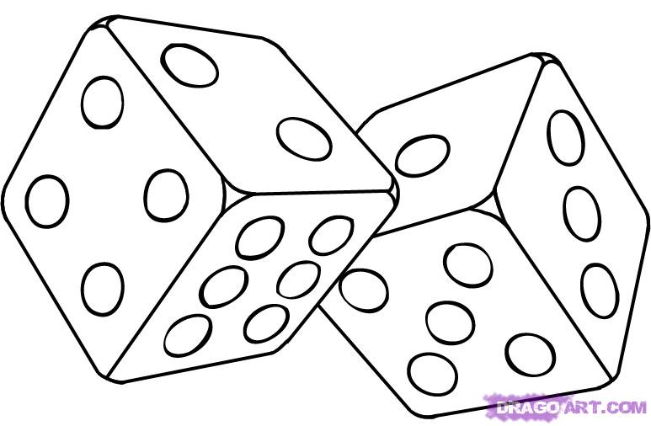

Example
Let’s calculate the chance of throwing a 6 on a dice
P (throwing a 6) = $\frac{Number of sides with a 6}{Total number of sides}$ = $\frac{1}{6}$ = 0.1667

Slide 8
Multiplication & Addition Rules

Slide 9
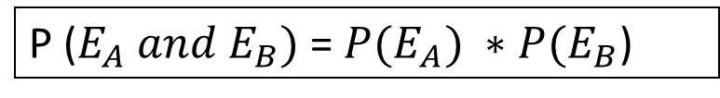
Multiplication Rule
The Multiplication Rule is used when:
You want to know the probability of two or more things happening
For example: I want to know the chance of first throwing a 6 AND then throwing a 4
Answer: P(throwing a 6) * P(throwing a 4)
= (1/6) * (1/6) = 1/36 = 0.0278
P ($E_{A} and E_{B})$ = ${P(E}_{A}) ∗P(E_{B}$)

Slide 10
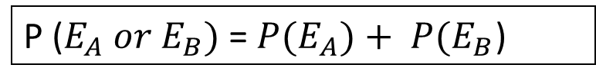
Addition Rule
The Addition Rule is used when:
We want to know the probability either (or all) of several events occurs
For example: I want to know the chance of throwing a 6 OR a 4
Answer: P(throwing a 6) + P(throwing a 4)
= 1/6 + 1/6 = 2/6 = 0.3333
P ($E_{A} or E_{B})$ = ${P(E}_{A})+ P(E_{B}$)

Slide 11
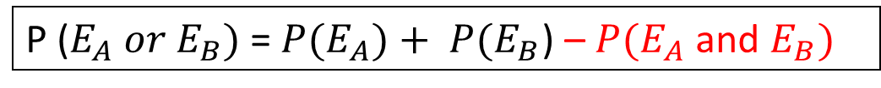
Addition Rule
Note that the addition rule in the previous slide only works when events are Exclusive (they cannot happen at the same time)
This is not always the case!
When Events are NOT exclusive we use:
P ($E_{A} or E_{B})$ = ${P(E}_{A})+ P(E_{B}$) – ${P(E}_{A}$ and $E_{B})$
Notes:
We do this to correct for double counting.

Slide 12
Addition Rule
Table showing preferred social media:
 | Instagram | Facebook | TikTok | Total
Lecturers | 10 | 20 | 10 | 40
Students | 20 | 10 | 30 | 60
Total | 30 | 30 | 40 | 100
What is the probability that a randomly picked person from this table either prefers tiktok or is a student?
P(student) = 0.6
P(TikTok) = 0.4
So P(Student or Tiktok) = 0.6 + 0.4 = 100%
That doesn’t seem right…

Slide 13
Addition Rule
Table showing preferred social media:
 | Instagram | Facebook | TikTok | Total
Lecturers | 10 | 20 | 10 | 40
Students | 20 | 10 | 30 | 60
Total | 30 | 30 | 40 | 100
The reason why the previous calculation didn’t work is because we included students who prefer tiktok twice.
So it should be:
P(Student) + P(Tiktok) - P(Student and Tiktok) =
0.6 + 0.4 – 0.3 = 0.7
Notes:
I often use the smartboard to draw circles around the tiktok fans and students so that you can see where it overlaps.

Slide 14
Exercise 1
As an insurance company you sell packages that combine both home insurance and car-liability insurance. 6% of homeowners made a claim on their insurance while 5% of car owners made a liability claim. The company will make a loss on a customer if they make a claim on one or both insurances.
If the company takes on a new customer, what is the probability that they will make a profit on them?
Write your answers in a python script.
Notes:
Note that this only works if we assume that the probability of a homeowner making a claim is not related to the probability of a car owner making a claim.
Source for these statistics:
https://www.iii.org/fact-statistic/facts-statistics-homeowners-and-renters-insurance
https://www.iii.org/fact-statistic/facts-statistics-auto-insurance

Slide 15
Exercise 1 solution
P(homeowner claim) = 0.06
P(car owner claim) = 0.05
P(two claims) = 0.06*0.05 = 0.003
P(loss) = 0.06 + 0.05 – 0.003 = 0.107
Therefore:
P(profit) = 1 - 0.107 = 0.893

Slide 16
Conditional Probability

Slide 17
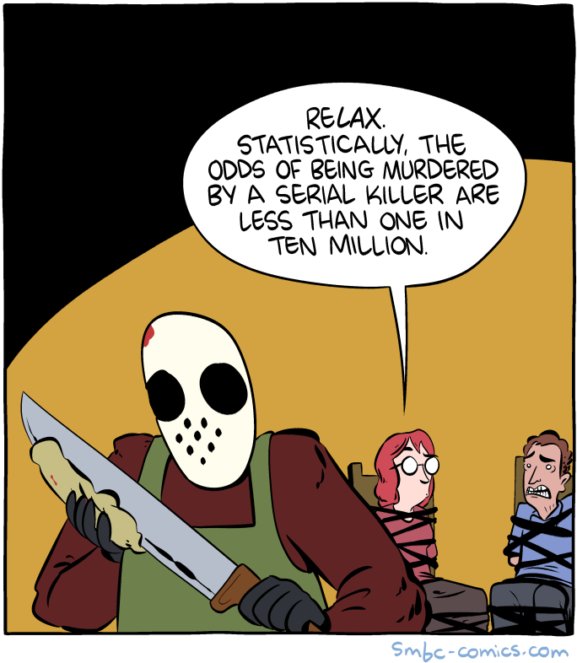
Why is she wrong?
Notes:
Students generally have an intuitive sense of why she is wrong, but cannot necessarily formulate it clearly. I always like to challenge them to try to explain clearly why she is wrong because it will help them understand conditional probability better

Slide 18
Conditional probability
Conditional probability is when we take a smaller part (a subset) from the total (e.g. only pick students) and calculate a probability within that subset.
The notation looks like this:
P(A|B)
It’s pronounced as: The probability of A given B
(Here A is the event and B is the condition)

Slide 19
Conditional probability Example
Table showing preferred social media:
 | Instagram | Facebook | TikTok | Total
Lecturers | 10 | 20 | 10 | 40
Students | 20 | 10 | 30 | 60
Total | 30 | 30 | 40 | 100
What is the probability that someone likes TikTok given that they are a student?
In other words: P(TikTok|Student)?

Slide 20
Conditional probability Example Answer
 | Instagram | Facebook | TikTok | Total
Lecturers | 10 | 20 | 10 | 40
Students | 20 | 10 | 30 | 60
Total | 30 | 30 | 40 | 100
P(TikTok|Student) = P(A|B)
There are 30 students who prefer TikTok (A)
There are 60 students in total (B)
Therefore: P(A|B) = 30/60 = 0.5

Slide 21
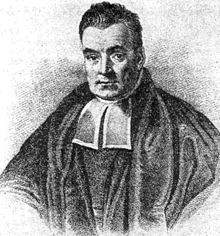
Bayes Theorem
Bayes Theorem is a method of quantifying the probability of an event give some evidence.
It is very useful because that when you get new evidence you can update your prior beliefs
It is also used in machine learning applications (e.g. Naïve Bayes).
Notes:
The picture shows Thomas Bayes (maybe). Interestingly, we know very little of the man who turned out to be very influential later on.

Slide 22
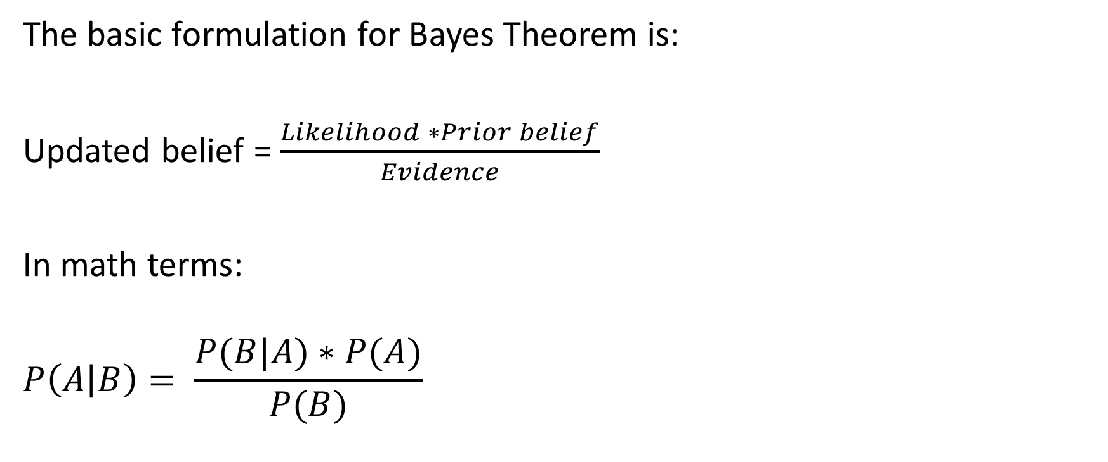
Bayes Theorem
The basic formulation for Bayes Theorem is:
Updated belief = $\frac{Likelihood ∗Prior belief}{Evidence}$
In math terms:
$$P\left(A | B\right)= \frac{P(B|A)∗P(A)}{P(B)}$$

Slide 23
Example: Farmers and Librarians
From the book Thinking fast and slow by Daniel Kahneman:
An individual has been described by a neighbor as follows:
“Steve is very shy and withdrawn, invariably helpful but with little interest in people or in the world of reality. A meek and tidy soul, he has a need for order and structure, and a passion for detail.”
Is Steve more likely to be a librarian or a farmer?
Notes:
Most students will probably say a librarian because the description of Steve better fits the stereotypes we have of librarians. However, the mistake here is that there are many more farmers than librarians, which makes it not necessarily true.

Slide 24
Farmers and Librarians
Now what is the probability that
Steve is a librarian (A)
Given that
They fit the description (B)
In other words: P(A|B)
Taken from: 3Blue1Brown at https://www.youtube.com/watch?v=HZGCoVF3YvM

Slide 25
Farmers and Librarians
Let’s say we know the following things:
40% of librarians fit the description
10% of farmers fit the description
There are 20 times more farmers than there are librarians
We can then know that, without considering the description, the probability that Steve is a farmer is simply 1/21
So P(Steve is a farmer) = P(A) = 0.0476
Taken from: 3Blue1Brown at https://www.youtube.com/watch?v=HZGCoVF3YvM

Slide 26
Farmers and Librarians
Let’s say we know the following things:
40% of librarians fit the description
10% of farmers fit the description
There are 20 times more farmers than there are librarians
Because 40% of librarians fit the description, we can also say that the probability that Steve fits the description, given they are a librarian is:
P(B|A) = 0.4
Taken from: 3Blue1Brown from https://www.youtube.com/watch?v=HZGCoVF3YvM

Slide 27
Farmers and Librarians
Finally, we need to know P(B) which is the probability that someone fits the description given (regardless of whether they are farmers or librarians).
This is the number of librarians that fit the description + the number of farmers that fit the description:
Probability that someone is a librarian that fits the description =
0.4 * 1/21
Probability that someone is a farmer that fits the description =
0.1 * 20/21
So P(B) = 0.4 * 1/21 + 0.1*20/21 = 0.1143

Slide 28

Farmers and Librarians
Let’s find out the answer
P(A) = 0.0476
P(B) = 0.1143
P(B|A) = 0.4
$P\left(A | B\right)= \frac{P(B|A)∗P(A)}{P(B)}$ = $\frac{0.4∗0.0476}{0.1143}$ = 0.1667
Notes:
The 3Blue1Brown video uses a geometric approach to visualize it, but you can also draw a tree diagram with the first branch being farmers/librarians and the second branch being fits the description/does not fit the description.

Slide 29
Exercise
Conditional probability is a recurring problem in medicine:
Let’s say that we have developed a test for Malaria which is 95% accurate
Let’s also say that people have a 1% chance of being affected with Malaria
This means that, if you have Malaria there is a 5% chance that you are told you are not sick (False negative).
It also means that if you do not have Malaria, there is a 5% chance you are told you are sick (False Positive).
If the test result is positive (the test says you have Malaria), what is the chance you are not actually sick?
In other words: P(not sick|positive test result)?
Write a Python code that prints the answer. Write it in such a way that it can easily update if some facts (e.g. accuracy rate) change.
Notes:
Do this exercise in class

Slide 30
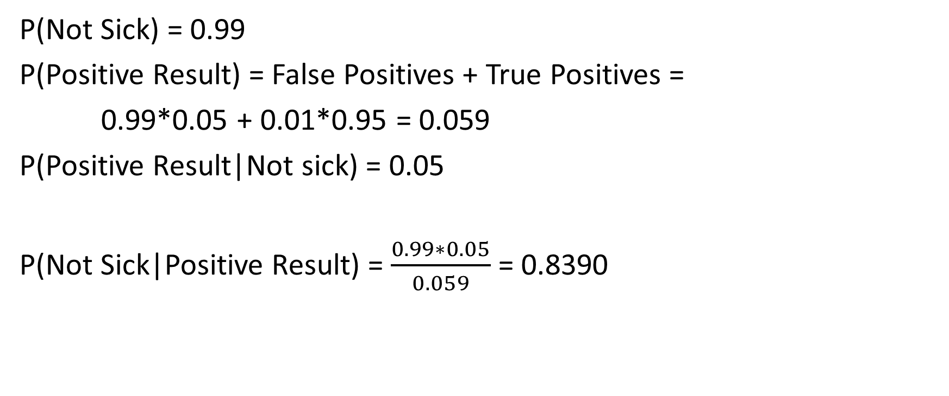
Exercise Solution
P(Not Sick) = 0.99
P(Positive Result) = False Positives + True Positives =
0.99*0.05 + 0.01*0.95 = 0.059
P(Positive Result|Not sick) = 0.05
P(Not Sick|Positive Result) = $\frac{0.99∗0.05}{0.059}$ = 0.8390
Notes:
These results show that even if a test is very accurate, you will get many false positives anyway if the disease is very rare.

Slide 31
Probability Distributions

Slide 32
Probability Distributions
A probability Distributions =
An overview of all possible outcomes of an experiment
It shows how likely every outcome is
(Experiment is doing something that can have many different outcomes,
e.g. rolling a dice, drawing a card, flipping a coin etc.)
Different kinds of variables have different kinds of distributions!

Slide 33
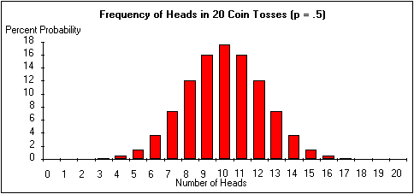
Probability Distribution Example
Image Source: https://records.viu.ca/~johnstoi/maybe/maybe5.htm
Notes:
This is an example of a probability distributions because it literally shows a distributions of all possible outcomes of throwing heads, as well as the probability of each outcome

Slide 34
Random Variables
Random Variables are at the basis of probability theory
They determine all of the possible values a variable can take
It is called Random because:
The outcome is drawn randomly from within a certain range
E.g. the outcome of flipping a coin is random
But the probability is not random!
The probability is determined by the probability distribution!

Slide 35
Binomial Distributions
There are three key concepts in a binomial distribution:
n → number of trials
p → probability of an outcome
X → The random variable (how many of a certain outcome)

Slide 36

Binomial Distribution
Let’s say I have a deck of cards and I want to calculate the probability of picking a heart
In this case:
n = 1
p = 0.25
X = number of hearts picked
If I just pick 1 card there are only 2 possible outcomes: you pick a heart (1) or you pick something else (0)
P (x = 0) = 0.75
P (x = 1) = 0.25

Slide 37
Binomial Distributions
If I pick 2 cards* the probability overview changes
n = 2
p = 0.25
X = number of hearts picked
P (x = 0) = 0.75*0.75 = 0.5625
P (x = 1) = 0.25*0.75 + 0.75*0.25 = 0.3750
P (x = 2) = 0.25*0.25 = 0.0625
*They need to be treated as independent events. So once you pick one from the deck you put it back before you pick another one.

Slide 38
Binomial Distributions
0.6
0.5
probability
0.4
0.3
0.2
0.1
0
0
1 2
number of Hearts when two cards are picked

Slide 39
Binomial Distributions
If I pick 3 cards it becomes even more complicated:
n = 3
p = 0.25
X = number of hearts picked
P (x = 0) = 0.4219
P (x = 1) = 0.4219
P (x = 2) = 0.1406
P (x = 3) = 0.0156

Slide 40
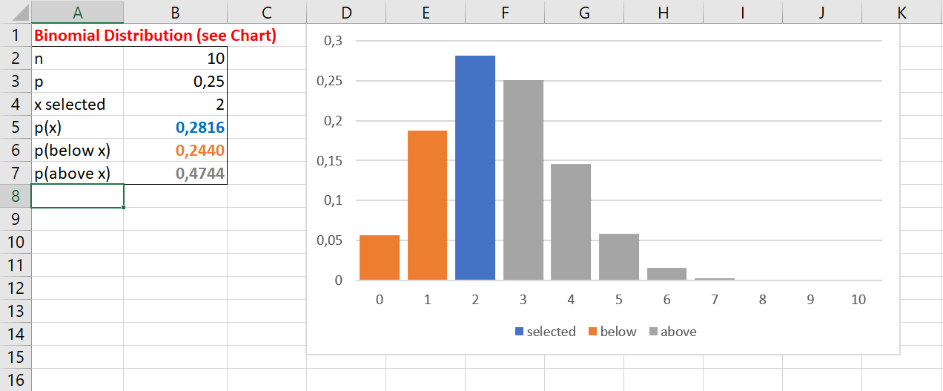
Binomial Distributions
What if you pick 10 cards?
The calculation becomes very complex :(
Solution:
Use PQRS :D
Notes:
This needs to be changed to python

Slide 41
Example
80% of trains are on time
We look at 4 trains
What is the probability that less than 3 trains are on time?
Is this binomial?
n= ?
p= ?
Notes:
This needs to be changed to python

Slide 42
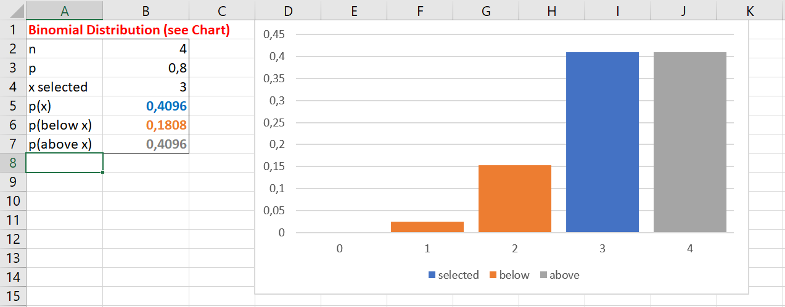
PQRS: Binomial n = 4 p = 0.8
P(x<3) = 0.1808
Notes:
This needs to be changed to python

Slide 43
Beta Distributions
In the previous example, it was assumed that we know the number of trains being on time.
But what if it’s the other way around?
That you measured how many trains (out of 4) are on time, and based on this data you want to know how likely it is that, for all trains in general, at most 80% are on time.
You can use a beta distribution!

Slide 44
Beta Distribution
While the binomial distribution models the probability of finding a certain number of successes, a beta distribution models the probability of something being a success.
So you calculate the probability of something being a certain probability.
For example: calculating the probability that the probability of a student failing an exam is 80%

Slide 45
Beta Distribution
A beta distribution has two parameters:
α = number of successes measured
β = number of failures measured
And the random variable you calculate:
X = the probability that something has a certain probability (or a lower one)

Slide 46
https://www.omnicalculator.com/statistics/beta-distribution
Notes:
This is a website that visualizes the beta distribution quite well.

Slide 47
Beta Distribution
So if 3 out of 4 trains are one time then:
α = 3
β = 1
And the probability of all trains having at most an 80% probability of being on time:
P(x ≤ 0.8) = 0.512

Slide 48
Exercise
You’re the owner of a webshop and last year the conversion rate was 3%. The conversion rate is the probability that a visitor makes a purchase. You made some changes to the website and tested it on 1000 customers. In this sample 38 customers ended up making a purchase.
What is the probability that at least 38 customers made a purchase assuming that the conversation rate has the stayed the same?
Based on the data, what is the probability that the conversion rate has become more than 4%?
Notes:
Conversion is rate is percentage of visitors that make a purchase

Slide 49
Answers
Binomial distribution, p = 0.03, n = 1000,
P(X ≥ 38) = 0.0858
b. Beta distribution: α = 38, β = 962
P(x > 0.04) = 1 – P(x ≤ 0.04) = 0.3534

Slide 50
Homework
Read Chapter 2 and do the exercises

